Slide 1
The Hydrologic Impacts of the Vermont Interstate Highway System
Ana Vang
LS00376_001
South Burlington-1961
Notes:
Hi, thanks for coming to my thesis proposal presentation entitled the hydrologic impacts of the vermont interstate system.

Slide 2
Outline
Project Goals
Interstate History
Vermont Interstate
Build-out and Impervious Surface
Vermont’s Exits and Study Site Selection
Aerial and Ground Based Rephotography
Summer 2012 Fieldwork
Hydraulic Modeling
Notes:
In the next 25 minutes I will be presenting my goals, a history of the Interstate system, my study sites, …

Slide 3
Landscape Change Program
Funded by NEH
Documents change
in Vermont
Interstate photos
Summer team of 4

Slide 4
Goals
Determine how the building of the interstate has changed the hydrology of Vermont
Hypothesis: I will test whether construction of the interstate and the associated build-out increased the amount of impermeable surface sufficient to change peak flow and run off volume, and if so whether I can relate this to changes in stream planform, incision depth, and bed material.
Notes:
When starting this project I wanted to know how and to what degree the building of the interstate and it’s associated development have changed the hydrology of vermont.

Slide 5
Interstate History
Federal-Aid Highway and Highway Revenue Acts of 1956
75440 km long
>170 km² paved area
32 billion m³ moved
$215 billion (2012)
LS37411_000-Middlesex-1959
Kaszynski, 2000; Missouri Department of Transportation, 2012; Obenberger and DeSimone, 2011
Notes:
32 billion = 1.5 lake champ volume
90% federally funded

Slide 6
Vermont Interstate System
Constructed from
1958-1983
516 km long
12 km² area
53 exits
Smith, 2006; Vermont Department of Highways, 1965; Vermont Agency of Transportation, 2012
Notes:
The interstate system in Vermont was constructed from 1958 to 1983. Three major interstates are present in vermont. … say where each is located and that i93 was last. The system is 516 km long and has 53 exits.

Slide 7
Impervious Surface
US EPA: 2003

Slide 8
Vermont’s Impervious Surface
Interstate: 516 km
Area/km: 22,800 m²
Total Area: 11.8 km²
Paved Road: 10,878 km
Area/km: 9600 m²
Total Area: 92.2 km²

Slide 9
Vermont’s Impervious Surface
Interstate: 516 km
Area/km: 22,800 m²
Total Area: 11.8 km²
Paved Road: 10,878 km
Area/km: 9600 m²
Total Area: 92.2 km²
The interstate is 4.5% of paved roads by length but 10% by area

Slide 10
Interstate Build-Out
Catalyzed build-out
Increased impervious surface
LS09591_000-Hartford-1959
Martin van Dalen Flickr
LS37361_000-South Burlngton-1959
Notes:
Link impervious to buildout,
Before and after of williston or south burlington (dorset street) – catalyzed by interstate,
Along with the construction of the interstate, comes interstate related development. This includes exits lined with big box stores and chain restaurants as well as suburban home development. Vermont has made a concerted effort to avoid some of the trappings and development often associated with the interstate. In 1968, Vermont banned all billboards in the state and compromised by allowing roadsides that list businesses. The Vermont Land Trust was another effort to keep Vermont from changing in the wake of interstate construction. The Land Trust goes to farms in vermont and offers to buy the development rights to their property, so that in the future the landscape remains disticly agrarian. Finally, Vermont strongly resisted the construction of box box stores and while they were eventually built, still exist in much lower concentrations than in most states.

Slide 11
Why do we care?
Changes in:
Flow paths
Flood peak
Stream morphology
Water quality
Ground water recharge
Increased impervious area = Landscape change
USFWS: 2011 Bethel
Notes:
Do more. Specifics …. Explain picture, higher flow peak – more capable of eroding material, lateral movement, lanscape link
At bottom = landscape change

Slide 12
How do we study changes and test hypothesis?
Rephotography
Fieldwork
Hydraulic Modeling
Nomad Tales-NSW/Flickr
US ACE
Notes:
Hydrologic modeling

Slide 13
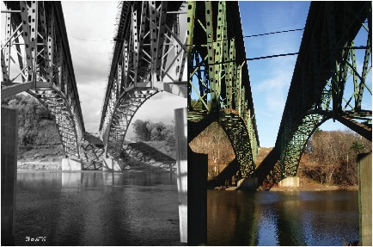
How do we study changes and test hypothesis?
LS38134_000-Brattleboro-1960
2011
Ground Based Rephotography
LS00376_000/LS00376_001-South Burlington-1961
Notes:
Bridge of the INTERSTATE, big red arrow agradation!

Slide 14
How do we study changes and test hypothesis?
1927
Aerial Rephotography
2004
LS01472_000-Middlesex
LS01472_001-Middlesex
Notes:
Do more, the interstate widened right of way,
Walk people through it, start at 1927- ag field less pavement …
Go to 2004, what happened w/interstate , added pavement, connectivity and flow. Talk more about the connectivity of the landscape. Linear strips.
Linear interstate flow into river/infiltrate
Walmart – storm water less infiltration

Slide 15
How do we study changes and test hypothesis?
HEC-HMS
Inputs
Drainage area
% Impervious
Precipitation
Outputs
Hydrograph data
Time to peak discharge
Runoff contribution
Notes:
Under the hood, how does it work.
Imp for overall watershed or bits and pieces?

Slide 16
How does this all work together?
Aerial Rephotography
(% impervious)
Hydraulic Model
Hydrograph, run off, peak discharge data
Hydrograph, run off, peak discharge data
Aerial Rephotography
(stream planform)
Test Hypothesis
Ground Based Rephotography
(incision, aggradation, etc)
I will test whether construction of the interstate and the associated build-out increased the amount of impermeable surface sufficient to change peak flow and run off volume, and if so whether I can relate this to changes in stream planform, incision depth, and bed material.

Slide 17
Work Completed
Photo processing
Interstate exit classification
Site selection

Slide 18
Vermont Interstate Photos
50,000 images
>13,000 Public Interstate Images
>36,000 Interstate Collection
Notes:
Slide early on about neh funding negatives, public 13000, 18522 in database
Picture of photographers notebook

Slide 19
What do Vermont’s exits look like?
Undeveloped/Basic Services
Notes:
Take impervious!
This past fall I took a road trip around Vermont to determine the state of the interstate and it’s exits. I was able to separate the exits into three categories: basic services and undeveloped, commercial, and residential.

Slide 20
What do Vermont’s exits look like?
Commercial
Notes:
Google walmart in place of

Slide 21
What do Vermont’s exits look like?
Residential

Slide 22
What do Vermont’s exits look like?
Undeveloped/Basic Services: 14
Commercial: 21
Residential: 16
Modified from Vermont Agency of Transportation, 2012
Notes:
How do they behave hydrologically.
Result map.
NEH Committee – narrrow down

Slide 23
Site Selection
Notes:
Based on suggestions by my NEH comitttee I narrow down the number of potential study towns to 20.
Current Development

Slide 24
Site Selection
Notes:
Based on suggestions by my NEH comitttee I narrow down the number of potential study towns to 20.
Current Development

Slide 25
Site Selection
Notes:
Based on suggestions by my NEH comitttee I narrow down the number of potential study towns to 20.
Current Development pictures – illustrate it. Lots of change.

Slide 26
Site Selection
Basic Services/Undeveloped:
Bethel
Springfield
Commercial:
Hartford
Lyndonville
Montpelier
St. Albans
Williston
Winooski
Residential
Barton
Dummerston
Richmond
Modified from Vermont Agency of Transportation, 2012

Slide 27
Summer/Fall Work
Ground based rephotography
Fieldwork
Final study site selection
Aerial rephotography
Hydraulic modeling

Slide 28
Ground Based Rephotography
LS00376_000/LS00376_003-South Burlington-1961/1964
Notes:
Beginning and end extreme then animation

Slide 29
Ground Based Rephotography

Slide 30
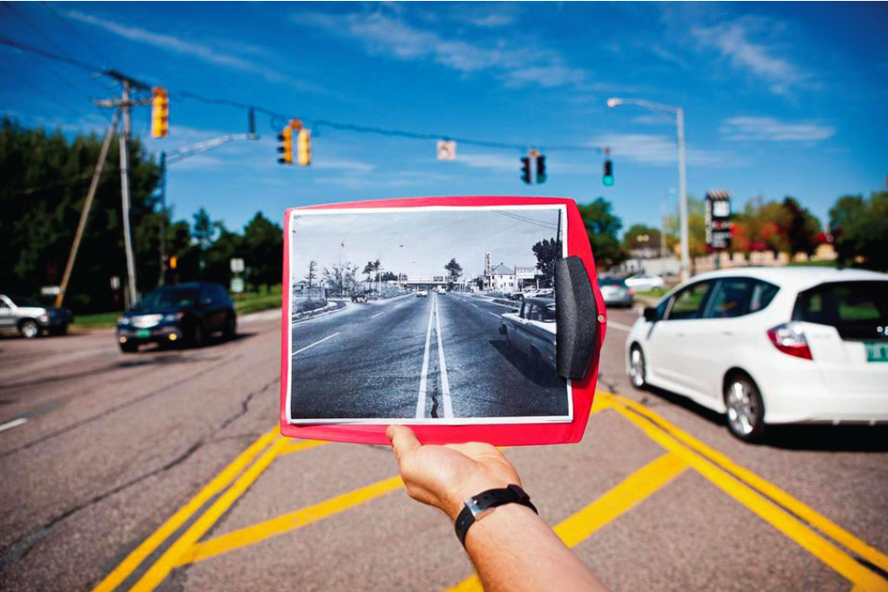
Fieldwork
Rephotography
Bridge piers
Near slopes
Drainage
Walking stretches of river with air photos in hand
Scour
Aggradation
Boston Globe

Slide 31
Final Study Sites
4 Sites
Spectrum of variables
Placement within watershed
Modified from Vermont Agency of Transportation, 2012

Slide 32
Aerial Rephotography
Edwards
Notes:
Two vertical aerials. VCGI. Ties more to collateral buildout

Slide 33
Aerial Photo Availability

Slide 34
Hydraulic modeling: HEC-HMS
Input:
Delineate sub-basins
Impervious % from aerial photos
Compare model outputs to field data
Notes:
Dig into program
Based on curve#’s?

Slide 35
Thesis Outcomes
Quantify amount impervious surface, over time, at 4 study sites of varying character
Document current conditions in streams with summer fieldwork
Document change in conditions with aerial and ground rephotography
Model the effect of increased impervious on surface hydrology
Attempt to link the amount and type of impervious change with channel change

Slide 36
Timeline
Timing | Task
Spring 2012 | -Contact local historical societies, town clerks, and listers -Determine method for quantifying imperviousness in historical photos
Summer 2012 | -Photograph and enter ground-based rephotography in LSC Database -Choose 4 final study sites -Learn to use HEC-HMS model
Fall 2012 | -Write introduction/methods -Rectify and analyze rephotographs -Rectify and analyze aerial photographs -Run HEC-HMS model for final study sites -Prepare and present progress report
Spring 2013 | -Finish running models -Compare model results to field data -Write results/conclusions and defend thesis
Notes:
What’s my thesis …

Slide 37
Questions?
LS07832-Fairlee- 1970

Slide 38
Site Selection
Notes:
Based on suggestions by my NEH comitttee I narrow down the number of potential study towns to 20.
Current Development

Slide 39
Hydraulic modeling: HEC-RAS
Sediment transport/movable boundary computation
Range of simulation times
Simulate hydraulic sorting
Estimate scour in floods
Estimate sedimentation

Slide 40
Other slide ideas
Expand on summer work
Expand on modeling
In summary
Comments from presentation
Stream geomorphology, exp pics, list exactly what data I’m looking for. Go over how I’m surveying
Go over inputs and outputs of models
Go over method for quantifying impervious space
Break up writing thesis along the way
Data flow diagram for numerical inputs
Split up fieldwork slide

